Slide 1
AGENDA
Vision and Mission Voting Results
Group Norms
Meet the Presenters
Introduce Problems to Policies
Examples
Building Toward our Future
Announcements
Notes:
Mike 2 min

Slide 2

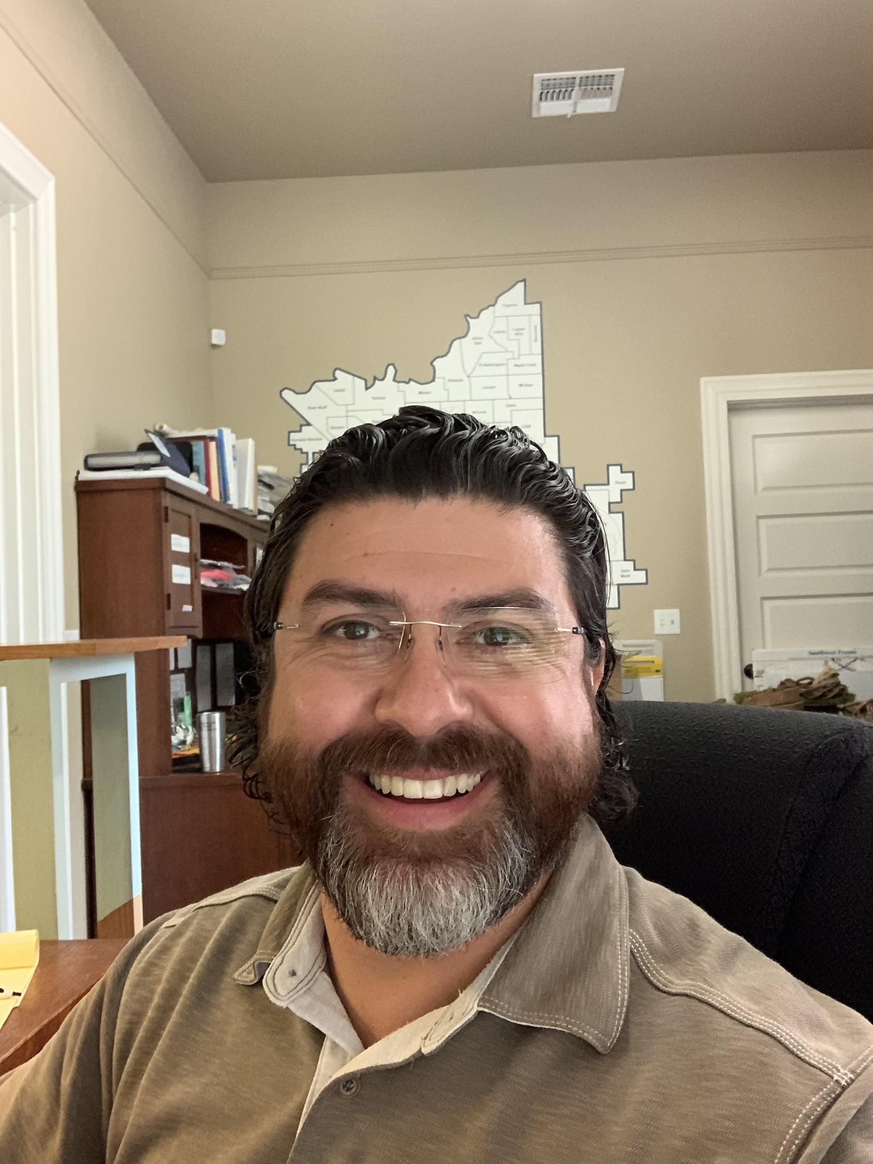
Daniel Dominguez
Neighborhood Development Coordinator
Daniel joined the ENP team in 2018 and is focused on the development of the assets, gifts, talents, and abilities of residents in the South-West region of Fresno. Daniel is a former Director of Diversity and Inclusion. Daniel also co-founded an urban ministry training program, Casa Shalom, which focused on Leadership Development, Social Justice, and Biblical Community. Five years ago, in response to prayer, the Dominguez’s relocated into Fresno’s Tower District and more specifically the Susan B. Neighborhood. Daniel prefers coffee over tea, flour tortillas over corn, and believes his wife's Tres Leches cake is the best there is in the whole world. Daniel is also happily married to his wife, Brenda, and they have three children; Daniel 5yr, Eliana 3yr, & Santiago 4months. Daniel has a Bachelor’s degree in Christian Ministry and Leadership and most of all believes that a river of information is way better than a reservoir.
Notes:
Daniel introduces himself and the work he does for ENP
3-5 minutes

Slide 3

SYSTEMS ICEBERG
Notes:
Daniel revisits the systems iceberg structure and makes connections to the problems to policies.
3-5 min

Slide 4
Next Training:
REAP Training #5
Forming a Policy Agenda
Tuesday, November 30th from 5:30-7pm
Or
Saturday, December 4th from 10-11:30am
SAVE THE DATE DECEMBER 11th 10:00 am-1:00 pm
ISSUES ASSEMBLY
Notes:
Mike

